Slide 1
MATLAB for image processing Session 2: Matrices and image processing

Slide 2
Course structure
Session 1
Introduction to MATLAB
Data types
Conditional statements and loops
Session 3
Advanced data structures
Advanced image reading (Bioformats)
Object-oriented programming
Session 2
Arrays and matrices
Image processing
Session 4
Figures and plotting
Designing a user interface

Slide 3

Under construction!
Comments/requests?
Let me know!
stephen.cross@bristol.ac.uk

Slide 4
Arrays and matrices
Notes:
Convert this into 2 spider diagrams if there’s time

Slide 5
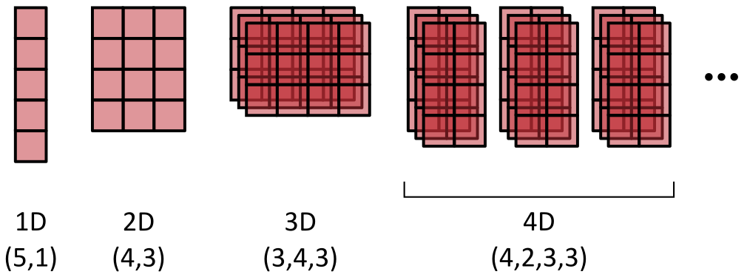
Introduction to arrays
So far we’ve only looked at variables holding a single value
Arrays hold multiple numeric values in an n-dimensional grid
MATLAB is specifically optimised for calculations on these
Have a minimum of 2 dimensions (XY)
XY dimensions always specified first in the order (row, column)

Slide 6
Introduction to arrays
Before we go further, a bit of terminology
In the literature you’ll often see “matrix” and “array” used interchangeably
Array
An N-dimensional, ordered collection of data
Vector
A 1D array
Matrix
A 2D array

Slide 7
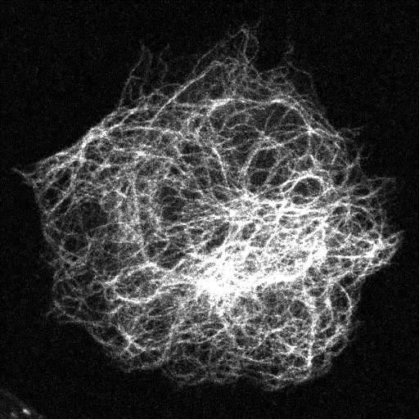
Introduction to matrices
Images are an example of a matrix
Pixels stored on regular grid
Each element (pixel) accessed by its coordinates
Often referred to as “indexing”
Moving beyond 2D
Higher dimensionalities used for colour, depth and/or time

Slide 8
Introduction to matrices
Images are an example of a matrix
Pixels stored on regular grid
Each element (pixel) accessed by its coordinates
Often referred to as “indexing”
Moving beyond 2D
Higher dimensionalities used for colour, depth and/or time

Slide 9
Introduction to matrices
Column index
Images are an example of a matrix
Pixels stored on regular grid
Each element (pixel) accessed by its coordinates
Often referred to as “indexing”
Moving beyond 2D
Higher dimensionalities used for colour, depth and/or time
1 | 2 | 3 | 4 | 5 | 6 | 7 | 8 | 9 | 10
1
2
3
4
5
6
7
8
9
10
67 | 80 | 94 | 100 | 141 | 115 | 138 | 155 | 185 | 233
79 | 76 | 56 | 59 | 73 | 125 | 135 | 121 | 126 | 148
89 | 63 | 98 | 36 | 67 | 84 | 107 | 135 | 119 | 138
73 | 52 | 82 | 72 | 106 | 112 | 94 | 112 | 103 | 135
93 | 61 | 63 | 101 | 139 | 111 | 105 | 94 | 75 | 100
122 | 133 | 140 | 181 | 152 | 137 | 122 | 54 | 52 | 73
234 | 194 | 188 | 155 | 153 | 121 | 96 | 47 | 65 | 112
240 | 188 | 132 | 109 | 147 | 144 | 114 | 122 | 84 | 124
133 | 139 | 140 | 120 | 146 | 167 | 151 | 145 | 101 | 102
120 | 82 | 132 | 108 | 113 | 89 | 112 | 136 | 123 | 79
Row index

Slide 10
Introduction to matrices
Images are an example of a matrix
Pixels stored on regular grid
Each element (pixel) accessed by its coordinates
Often referred to as “indexing”
Moving beyond 2D
Higher dimensionalities used for colour, depth and/or time
Original
Red
Green
Blue
+
+
Colour / wavelength

Slide 11
Introduction to matrices
Images are an example of a matrix
Pixels stored on regular grid
Each element (pixel) accessed by its coordinates
Often referred to as “indexing”
Moving beyond 2D
Higher dimensionalities used for colour, depth and/or time
Original
Red
Green
Blue
+
+
Colour / wavelength

Slide 12
Introduction to matrices
Images are an example of a matrix
Pixels stored on regular grid
Each element (pixel) accessed by its coordinates
Often referred to as “indexing”
Moving beyond 2D
Higher dimensionalities used for colour, depth and/or time
Depth / z-position

Slide 13
Introduction to matrices
Images are an example of a matrix
Pixels stored on regular grid
Each element (pixel) accessed by its coordinates
Often referred to as “indexing”
Moving beyond 2D
Higher dimensionalities used for colour, depth and/or time
Time

Slide 14
Accessing matrix values
Notes:
Convert this into 2 spider diagrams if there’s time

Slide 15
Indexing matrices
Elements of a matrix indexed using parenthesis
First index specifies row, second specifies column
Index numbering starts at 1
Example, a random number array
Create a matrix: rand_array = rand(4, 3)
Top-left value: tl_val = rand_array(1, 1)
Bottom-left val: bl_val = rand_array(4, 1)
Top-right val: tr_val = rand_array(1, 3)

Slide 16
Indexing matrices
Elements of a matrix indexed using parenthesis
First index specifies row, second specifies column
Index numbering starts at 1
Example, a random number array
Create a matrix: rand_array = rand(4, 3)
Top-left value: tl_val = rand_array(1, 1)
Bottom-left val: bl_val = rand_array(4, 1)
Top-right val: tr_val = rand_array(1, 3)
0.9 | 0.3 | 0.1
0.2 | 0.1 | 0.5
0.4 | 0.7 | 0.2
0.7 | 0.3 | 0.5

Slide 17
Indexing matrices
Elements of a matrix indexed using parenthesis
First index specifies row, second specifies column
Index numbering starts at 1
Example, a random number array
Create a matrix: rand_array = rand(4, 3)
Top-left value: tl_val = rand_array(1, 1)
Bottom-left val: bl_val = rand_array(4, 1)
Top-right val: tr_val = rand_array(1, 3)
0.9 | 0.3 | 0.1
0.2 | 0.1 | 0.5
0.4 | 0.7 | 0.2
0.7 | 0.3 | 0.5

Slide 18
Indexing matrices
Elements of a matrix indexed using parenthesis
First index specifies row, second specifies column
Index numbering starts at 1
Example, a random number array
Create a matrix: rand_array = rand(4, 3)
Top-left value: tl_val = rand_array(1, 1)
Bottom-left val: bl_val = rand_array(4, 1)
Top-right val: tr_val = rand_array(1, 3)
0.9 | 0.3 | 0.1
0.2 | 0.1 | 0.5
0.4 | 0.7 | 0.2
0.7 | 0.3 | 0.5

Slide 19
Indexing matrices
Elements of a matrix indexed using parenthesis
First index specifies row, second specifies column
Index numbering starts at 1
Example, a random number array
Create a matrix: rand_array = rand(4, 3)
Top-left value: tl_val = rand_array(1, 1)
Bottom-left val: bl_val = rand_array(4, 1)
Top-right val: tr_val = rand_array(1, 3)
0.9 | 0.3 | 0.1
0.2 | 0.1 | 0.5
0.4 | 0.7 | 0.2
0.7 | 0.3 | 0.5

Slide 20
Indexing matrices
Exercise: Indexing a single value in a matrix
Create a random number matrix with 5 rows and 4 columns
- Skip the semicolon at the end of the line, so we can see the matrix
Access the bottom right element and store as a new variable
Does the new variable have the correct value?

Slide 21
Indexing matrices
We can access more than one value at a time
Use the colon operator to specify entire row/column
Using the random number array as an example
All first row: row_1 = rand_array(1, :)
All second column: col_2 = rand_array(:, 2)
All third row: row_3 = rand_array(3, :)

Slide 22
Indexing matrices
We can access more than one value at a time
Use the colon operator to specify entire row/column
Using the random number array as an example
All first row: row_1 = rand_array(1, :)
All second column: col_2 = rand_array(:, 2)
All third row: row_3 = rand_array(3, :)
0.9 | 0.3 | 0.1
0.2 | 0.1 | 0.5
0.4 | 0.7 | 0.2
0.7 | 0.3 | 0.5

Slide 23
Indexing matrices
We can access more than one value at a time
Use the colon operator to specify entire row/column
Using the random number array as an example
All first row: row_1 = rand_array(1, :)
All second column: col_2 = rand_array(:, 2)
All third row: row_3 = rand_array(3, :)
0.9 | 0.3 | 0.1
0.2 | 0.1 | 0.5
0.4 | 0.7 | 0.2
0.7 | 0.3 | 0.5

Slide 24
Indexing matrices
We can access more than one value at a time
Use the colon operator to specify entire row/column
Using the random number array as an example
All first row: row_1 = rand_array(1, :)
All second column: col_2 = rand_array(:, 2)
All third row: row_3 = rand_array(3, :)
0.9 | 0.3 | 0.1
0.2 | 0.1 | 0.5
0.4 | 0.7 | 0.2
0.7 | 0.3 | 0.5

Slide 25
Indexing matrices
We can access more than one value at a time
Use the colon operator to specify entire row/column
Using the random number array as an example
All first row: row_1 = rand_array(1, :)
All second column: col_2 = rand_array(:, 2)
All third row: row_3 = rand_array(3, :)
0.9 | 0.3 | 0.1
0.2 | 0.1 | 0.5
0.4 | 0.7 | 0.2
0.7 | 0.3 | 0.5

Slide 26
Indexing matrices
Exercise: Indexing an entire row/column in a matrix
Create a random number matrix with 5 rows and 4 columns
- Skip the semicolon at the end of the line, so we can see the matrix
Access the 4th column and store as a new variable
Access the 5th row and store as a new variable
Do the new variables have the correct values?

Slide 27
Indexing matrices
We can also access just a subset of values
Use the colon operator with start and end indices
Specify a subset of the range with start:end form
Specify an interval range with start:interval:end form
Back to our random number array
Subset first column: sub_col_1 = rand_array(2:4, 1)
Subset second row: sub_row_2 = rand_array(2, 1:2)
2D subset: sub_2D = rand_array(3:4, 1:2)
Interval third column: inter_col_3 = rand_array(2:2:4, 3)

Slide 28
Indexing matrices
We can also access just a subset of values
Use the colon operator with start and end indices
Specify a subset of the range with start:end form
Specify an interval range with start:interval:end form
Back to our random number array
Subset first column: sub_col_1 = rand_array(2:4, 1)
Subset second row: sub_row_2 = rand_array(2, 1:2)
2D subset: sub_2D = rand_array(3:4, 1:2)
Interval third column: inter_col_3 = rand_array(2:2:4, 3)
0.9 | 0.3 | 0.1
0.2 | 0.1 | 0.5
0.4 | 0.7 | 0.2
0.7 | 0.3 | 0.5

Slide 29
Indexing matrices
We can also access just a subset of values
Use the colon operator with start and end indices
Specify a subset of the range with start:end form
Specify an interval range with start:interval:end form
Back to our random number array
Subset first column: sub_col_1 = rand_array(2:4, 1)
Subset second row: sub_row_2 = rand_array(2, 1:2)
2D subset: sub_2D = rand_array(3:4, 1:2)
Interval third column: inter_col_3 = rand_array(2:2:4, 3)
0.9 | 0.3 | 0.1
0.2 | 0.1 | 0.5
0.4 | 0.7 | 0.2
0.7 | 0.3 | 0.5

Slide 30
Indexing matrices
We can also access just a subset of values
Use the colon operator with start and end indices
Specify a subset of the range with start:end form
Specify an interval range with start:interval:end form
Back to our random number array
Subset first column: sub_col_1 = rand_array(2:4, 1)
Subset second row: sub_row_2 = rand_array(2, 1:2)
2D subset: sub_2D = rand_array(3:4, 1:2)
Interval third column: inter_col_3 = rand_array(2:2:4, 3)
0.9 | 0.3 | 0.1
0.2 | 0.1 | 0.5
0.4 | 0.7 | 0.2
0.7 | 0.3 | 0.5

Slide 31
Indexing matrices
We can also access just a subset of values
Use the colon operator with start and end indices
Specify a subset of the range with start:end form
Specify an interval range with start:interval:end form
Back to our random number array
Subset first column: sub_col_1 = rand_array(2:4, 1)
Subset second row: sub_row_2 = rand_array(2, 1:2)
2D subset: sub_2D = rand_array(3:4, 1:2)
Interval third column: inter_col_3 = rand_array(2:2:4, 3)
0.9 | 0.3 | 0.1
0.2 | 0.1 | 0.5
0.4 | 0.7 | 0.2
0.7 | 0.3 | 0.5

Slide 32
Indexing matrices
We can also access just a subset of values
Use the colon operator with start and end indices
Specify a subset of the range with start:end form
Specify an interval range with start:interval:end form
Back to our random number array
Subset first column: sub_col_1 = rand_array(2:4, 1)
Subset second row: sub_row_2 = rand_array(2, 1:2)
2D subset: sub_2D = rand_array(3:4, 1:2)
Interval third column: inter_col_3 = rand_array(2:2:4, 3)
0.9 | 0.3 | 0.1
0.2 | 0.1 | 0.5
0.4 | 0.7 | 0.2
0.7 | 0.3 | 0.5

Slide 33
Indexing matrices
Exercise: Indexing subsets in a matrix
Create a random number matrix with 5 rows and 4 columns
- Skip the semicolon at the end of the line, so we can see the matrix
Access columns 2-4 of row 5 and store as a new variable
Access rows 1,3 and 5 of column 2 and store as a new variable
Do the new variables have the correct values?
What size is the result from part 3?

Slide 34
Indexing matrices
Specify irregular subset as a vector (1D array)
Vectors written using square brackets
Using the 2D random number array
Subset from column 2: sub_col_2 = rand_array([1,2,4], 2)
Subset from row 4: sub_row_4 = rand_array(4, [2,3])
We could have done this another way…
Subset in 2D: sub_2D = rand_array([[1,3,4], [1,2])

Slide 35
Indexing matrices
Specify irregular subset as a vector (1D array)
Vectors written using square brackets
Using the 2D random number array
Subset from column 2: sub_col_2 = rand_array([1,2,4], 2)
Subset from row 4: sub_row_4 = rand_array(4, [2,3])
We could have done this another way…
Subset in 2D: sub_2D = rand_array([[1,3,4], [1,2])
0.9 | 0.3 | 0.1
0.2 | 0.1 | 0.5
0.4 | 0.7 | 0.2
0.7 | 0.3 | 0.5

Slide 36
Indexing matrices
Specify irregular subset as a vector (1D array)
Vectors written using square brackets
Using the 2D random number array
Subset from column 2: sub_col_2 = rand_array([1,2,4], 2)
Subset from row 4: sub_row_4 = rand_array(4, [2,3])
We could have done this another way…
Subset in 2D: sub_2D = rand_array([[1,3,4], [1,2])
0.9 | 0.3 | 0.1
0.2 | 0.1 | 0.5
0.4 | 0.7 | 0.2
0.7 | 0.3 | 0.5

Slide 37
Indexing matrices
Specify irregular subset as a vector (1D array)
Vectors written using square brackets
Using the 2D random number array
Subset from column 2: sub_col_2 = rand_array([1,2,4], 2)
Subset from row 4: sub_row_4 = rand_array(4, [2,3])
We could have done this another way…
Subset in 2D: sub_2D = rand_array([[1,3,4], [1,2])
0.9 | 0.3 | 0.1
0.2 | 0.1 | 0.5
0.4 | 0.7 | 0.2
0.7 | 0.3 | 0.5

Slide 38
Indexing matrices
Specify irregular subset as a vector (1D array)
Vectors written using square brackets
Using the 2D random number array
Subset from column 2: sub_col_2 = rand_array([1,2,4], 2)
Subset from row 4: sub_row_4 = rand_array(4, [2,3])
We could have done this another way…
Subset in 2D: sub_2D = rand_array([[1,3,4], [1,2])
0.9 | 0.3 | 0.1
0.2 | 0.1 | 0.5
0.4 | 0.7 | 0.2
0.7 | 0.3 | 0.5

Slide 39
Indexing matrices
Exercise: Indexing irregular subsets in a matrix
Create a random number matrix with 5 rows and 4 columns
- Skip the semicolon at the end of the line, so we can see the matrix
Access columns 1,2 and 4 of row 3 and store as a new variable
Access columns 1 and 4 of rows 2,3 and 5 and store as a new variable
Do the new variables have the correct values?
What size is the result from part 3?

Slide 40
Indexing matrices
Indexing higher dimensions
Uses exactly the same logic as in 2D
Add another dimension with an extra comma
Creating a random number 3D array
Create a 3D matrix: rand_array = rand(4, 3, 2)
Column 2 in slice 2: col_2 = rand_array(:, 2, 2)
Top-left in both slices: tl_val = rand_array(1, 1, :)
Row 1 in both slices: row_1 = rand_array(1, :, :)

Slide 41
Indexing matrices
Indexing higher dimensions
Uses exactly the same logic as in 2D
Add another dimension with an extra comma
Creating a random number 3D array
Create a 3D matrix: rand_array = rand(4, 3, 2)
Column 2 in slice 2: col_2 = rand_array(:, 2, 2)
Top-left in both slices: tl_val = rand_array(1, 1, :)
Row 1 in both slices: row_1 = rand_array(1, :, :)
0.2 | 0.2
1.0 | 0.4
0.5 | 0.2
0.5 | 0.0
0.7 | 0.8
0.1 | 0.7
Slice 1
Slice 2

Slide 42
Indexing matrices
Indexing higher dimensions
Uses exactly the same logic as in 2D
Add another dimension with an extra comma
Creating a random number 3D array
Create a 3D matrix: rand_array = rand(4, 3, 2)
Column 2 in slice 2: col_2 = rand_array(:, 2, 2)
Top-left in both slices: tl_val = rand_array(1, 1, :)
Row 1 in both slices: row_1 = rand_array(1, :, :)
0.2 | 0.2
1.0 | 0.4
0.5 | 0.2
0.5 | 0.0
0.7 | 0.8
0.1 | 0.7
Slice 1
Slice 2

Slide 43
Indexing matrices
Indexing higher dimensions
Uses exactly the same logic as in 2D
Add another dimension with an extra comma
Creating a random number 3D array
Create a 3D matrix: rand_array = rand(4, 3, 2)
Column 2 in slice 2: col_2 = rand_array(:, 2, 2)
Top-left in both slices: tl_val = rand_array(1, 1, :)
Row 1 in both slices: row_1 = rand_array(1, :, :)
0.2 | 0.2
1.0 | 0.4
0.5 | 0.2
0.5 | 0.0
0.7 | 0.8
0.1 | 0.7
Slice 1
Slice 2

Slide 44
Indexing matrices
Indexing higher dimensions
Uses exactly the same logic as in 2D
Add another dimension with an extra comma
Creating a random number 3D array
Create a 3D matrix: rand_array = rand(4, 3, 2)
Column 2 in slice 2: col_2 = rand_array(:, 2, 2)
Top-left in both slices: tl_val = rand_array(1, 1, :)
Row 1 in both slices: row_1 = rand_array(1, :, :)
0.2 | 0.2
1.0 | 0.4
0.5 | 0.2
0.5 | 0.0
0.7 | 0.8
0.1 | 0.7
Slice 1
Slice 2

Slide 45
Indexing matrices
Exercise: Indexing a 3D array
Create a random number 3D array with 5 rows, 4 columns and 3 slices
- Skip the semicolon at the end of the line, so we can see the matrix
Access value at row 3, column 2 of all slices and store as a new variable
Access entire second slice and store as a new variable
Do the new variables have the correct values?
What size is the result from part 2?

Slide 46
Indexing matrices
It’s also possible to index using a single number
This is called “linear indexing”
Uses order rows, then columns
Convert an ND array to 1D using single : operator
Demonstrating this with a 2D array
Create 2D array: rect_arr = rand(3, 2)
Second element: el_2 = rect_arr(2)
Fourth element: el_4 = rect_arr(4)
Fifth element: el_5 = rect_arr(5)
Convert to 1D: lin_arr = rect_arr(:)

Slide 47
Indexing matrices
It’s also possible to index using a single number
This is called “linear indexing”
Uses order rows, then columns
Convert an ND array to 1D using single : operator
Demonstrating this with a 2D array
Create 2D array: rect_arr = rand(3, 2)
Second element: el_2 = rect_arr(2)
Fourth element: el_4 = rect_arr(4)
Fifth element: el_5 = rect_arr(5)
Convert to 1D: lin_arr = rect_arr(:)
0.2 | 0.2
1.0 | 0.4
0.5 | 0.2

Slide 48
Indexing matrices
It’s also possible to index using a single number
This is called “linear indexing”
Uses order rows, then columns
Convert an ND array to 1D using single : operator
Demonstrating this with a 2D array
Create 2D array: rect_arr = rand(3, 2)
Second element: el_2 = rect_arr(2)
Fourth element: el_4 = rect_arr(4)
Fifth element: el_5 = rect_arr(5)
Convert to 1D: lin_arr = rect_arr(:)
0.2 | 0.2
1.0 | 0.4
0.5 | 0.2

Slide 49
Indexing matrices
It’s also possible to index using a single number
This is called “linear indexing”
Uses order rows, then columns
Convert an ND array to 1D using single : operator
Demonstrating this with a 2D array
Create 2D array: rect_arr = rand(3, 2)
Second element: el_2 = rect_arr(2)
Fourth element: el_4 = rect_arr(4)
Fifth element: el_5 = rect_arr(5)
Convert to 1D: lin_arr = rect_arr(:)
0.2 | 0.2
1.0 | 0.4
0.5 | 0.2

Slide 50
Indexing matrices
It’s also possible to index using a single number
This is called “linear indexing”
Uses order rows, then columns
Convert an ND array to 1D using single : operator
Demonstrating this with a 2D array
Create 2D array: rect_arr = rand(3, 2)
Second element: el_2 = rect_arr(2)
Fourth element: el_4 = rect_arr(4)
Fifth element: el_5 = rect_arr(5)
Convert to 1D: lin_arr = rect_arr(:)
0.2 | 0.2
1.0 | 0.4
0.5 | 0.2

Slide 51
Indexing matrices
It’s also possible to index using a single number
This is called “linear indexing”
Uses order rows, then columns
Convert an ND array to 1D using single : operator
Demonstrating this with a 2D array
Create 2D array: rect_arr = rand(3, 2)
Second element: el_2 = rect_arr(2)
Fourth element: el_4 = rect_arr(4)
Fifth element: el_5 = rect_arr(5)
Convert to 1D: lin_arr = rect_arr(:)
0.2
1.0
0.5
0.2
0.4
0.2
0.2 | 0.2
1.0 | 0.4
0.5 | 0.2

Slide 52
Indexing recap
Single value
Comma separated list of indices: val_1 = my_array(2, 3)
Full range
Replace axis index with colon: val_2 = my_array(3, :)
Complete subset
Specify start and end index: val_3 = my_array(5, 1:2)
Regular interval subset
Specify start and end with interval: val_4 = my_array(1:2:5, 3)
Irregular interval subset
Specify vector of indices: val_5 = my_array([2,4,5], 2)
0.2 | 0.5 | 0.4
0.9 | 0.3 | 0.1
0.2 | 0.1 | 0.5
0.4 | 0.7 | 0.2
0.7 | 0.3 | 0.5

Slide 53
Indexing recap
Single value
Comma separated list of indices: val_1 = my_array(2, 3)
Full range
Replace axis index with colon: val_2 = my_array(3, :)
Complete subset
Specify start and end index: val_3 = my_array(5, 1:2)
Regular interval subset
Specify start and end with interval: val_4 = my_array(1:2:5, 3)
Irregular interval subset
Specify vector of indices: val_5 = my_array([2,4,5], 2)
0.2 | 0.5 | 0.4
0.9 | 0.3 | 0.1
0.2 | 0.1 | 0.5
0.4 | 0.7 | 0.2
0.7 | 0.3 | 0.5

Slide 54
Indexing recap
Single value
Comma separated list of indices: val_1 = my_array(2, 3)
Full range
Replace axis index with colon: val_2 = my_array(3, :)
Complete subset
Specify start and end index: val_3 = my_array(5, 1:2)
Regular interval subset
Specify start and end with interval: val_4 = my_array(1:2:5, 3)
Irregular interval subset
Specify vector of indices: val_5 = my_array([2,4,5], 2)
0.2 | 0.5 | 0.4
0.9 | 0.3 | 0.1
0.2 | 0.1 | 0.5
0.4 | 0.7 | 0.2
0.7 | 0.3 | 0.5

Slide 55
Indexing recap
Single value
Comma separated list of indices: val_1 = my_array(2, 3)
Full range
Replace axis index with colon: val_2 = my_array(3, :)
Complete subset
Specify start and end index: val_3 = my_array(5, 1:2)
Regular interval subset
Specify start and end with interval: val_4 = my_array(1:2:5, 3)
Irregular interval subset
Specify vector of indices: val_5 = my_array([2,4,5], 2)
0.2 | 0.5 | 0.4
0.9 | 0.3 | 0.1
0.2 | 0.1 | 0.5
0.4 | 0.7 | 0.2
0.7 | 0.3 | 0.5

Slide 56
Indexing recap
Single value
Comma separated list of indices: val_1 = my_array(2, 3)
Full range
Replace axis index with colon: val_2 = my_array(3, :)
Complete subset
Specify start and end index: val_3 = my_array(5, 1:2)
Regular interval subset
Specify start and end with interval: val_4 = my_array(1:2:5, 3)
Irregular interval subset
Specify vector of indices: val_5 = my_array([2,4,5], 2)
0.2 | 0.5 | 0.4
0.9 | 0.3 | 0.1
0.2 | 0.1 | 0.5
0.4 | 0.7 | 0.2
0.7 | 0.3 | 0.5

Slide 57
Indexing recap
Single value
Comma separated list of indices: val_1 = my_array(2, 3)
Full range
Replace axis index with colon: val_2 = my_array(3, :)
Complete subset
Specify start and end index: val_3 = my_array(5, 1:2)
Regular interval subset
Specify start and end with interval: val_4 = my_array(1:2:5, 3)
Irregular interval subset
Specify vector of indices: val_5 = my_array([2,4,5], 2)
0.2 | 0.5 | 0.4
0.9 | 0.3 | 0.1
0.2 | 0.1 | 0.5
0.4 | 0.7 | 0.2
0.7 | 0.3 | 0.5

Slide 58
Creating matrices
Notes:
Convert this into 2 spider diagrams if there’s time

Slide 59
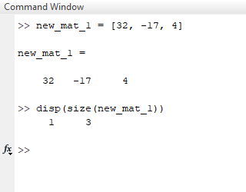
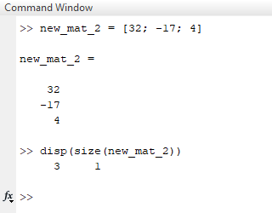
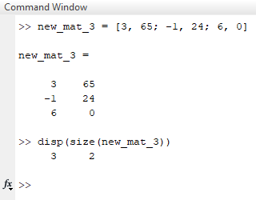
Creating 2D matrix from known values
Surround values with square brackets
Comma-separate items on the same row
Semicolon-separate rows
A single row
v1 = [32, -17, 4]
A single column
v2 = [32; -17; 4]
A true 2D matrix
v3 = [3, -65; -1, 24; 6, 0]

Slide 60
Combining matrices
Matrices can be joined along existing or new axes
Used to create higher dimensionalities than 2D
Using concatenation function
Create separate matrices, then join using cat function
First argument of cat specifies axis to concatenate along
By indexing
Create separate matrices, then merge one into the other
Not as simple to extend existing dimensions (cat is better)
We’ll look into indexing in more detail later on

Slide 61
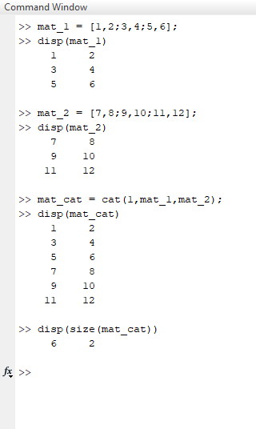
Combining matrices
Matrices can be joined along existing or new axes
Used to create higher dimensionalities than 2D
Using concatenation function
Create separate matrices, then join using cat function
First argument of cat specifies axis to concatenate along
By indexing
Create separate matrices, then merge one into the other
Not as simple to extend existing dimensions (cat is better)
We’ll look into indexing in more detail later on

Slide 62
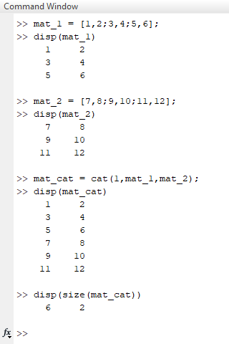
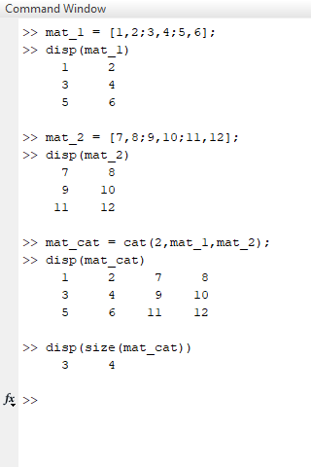
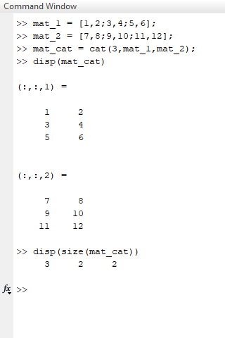
Combining matrices
Joining vertically
Joining horizontally
Joining along new axis

Slide 63
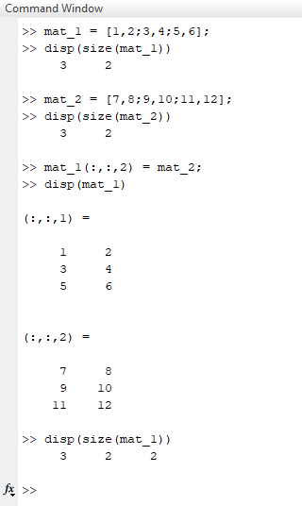
Combining matrices
Matrices can be joined along existing or new axes
Used to create higher dimensionalities than 2D
Using concatenation function
Create separate matrices, then join using cat function
First argument of cat specifies axis to concatenate along
By indexing
Create separate matrices, then merge one into the other
Not as simple to extend existing dimensions (cat is better)

Slide 64
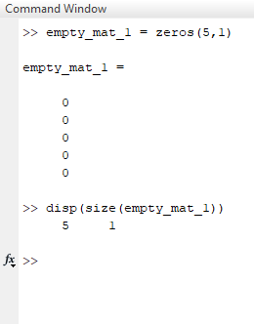
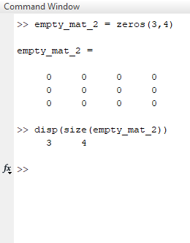
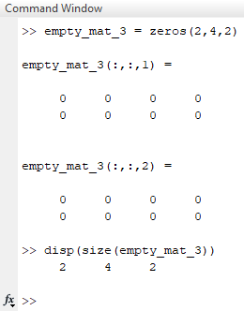
Creating an empty matrix
Initialising the empty matrix using zeros function
This preallocates the necessary memory
1D (ish)
2D
3D

Slide 65
The need for initialisation
Why can’t we create a small matrix and resize as necessary?
Matrices can be re-sized (e.g. via cat), but this is SLOW
Resize operations require the matrix to be moved in the PC’s memory
We can see this wasted time using a couple of tools
TicToc
Tells us the time between tic and toc commands
Profiler
A graphical tool to evaluate code performance in greater detail
Reports number of calls per line
Reports time taken per line

Slide 66
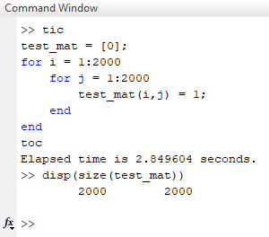
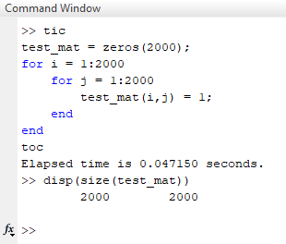
Tic Toc
Tells us the time between tic and toc commands
Start timing using tic command
Get the time elapsed since tic using toc command
Resizing array
Initialising with zeros

Slide 67
Tic Toc
1000px x 1000px
2000px x 2000px
3000px x 3000px

Slide 68
Profiler
Evaluates the time taken by each line of code
Only works for scripts and functions
Doesn’t work on code in the command window
Using the profiler
Start profiler using profile on
Stop profiler using profile off
View profile results using profiler viewer
Clear previous results with profile clear

Slide 69
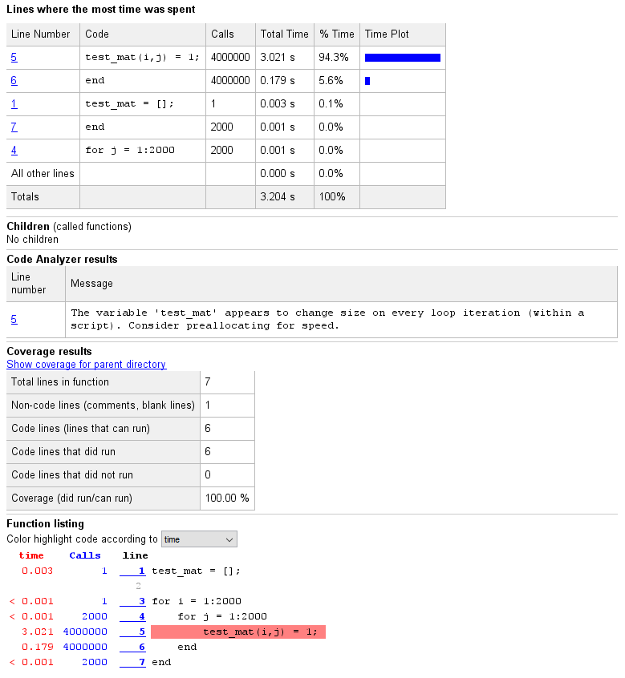
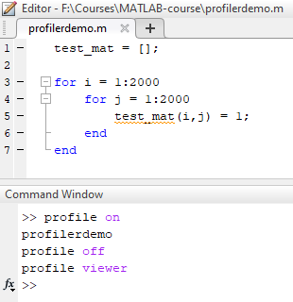
Profiler

Slide 70
Array and matrix operations
Notes:
Convert this into 2 spider diagrams if there’s time

Slide 71
Array and matrix operations
Perform an operation on all elements of an array in one go
Offer massive speed improvements
Array operations
Operate element-by-element
Can be applied on ND arrays
Some math operators preceded by .
Multiplication: .*
Division: ./
Power: .^
Can do logical tests (e.g. >, <, ==, etc.)
Matrix operations
Follow rules of linear algebra
Only for vectors (1D) and matrices (2D)
Use normal operator
Multiplication: *
Division: /
Power: ^

Slide 72
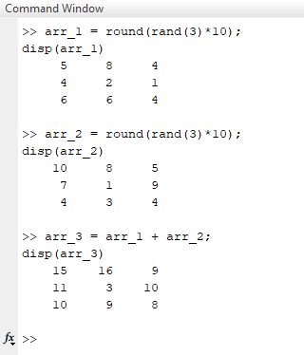
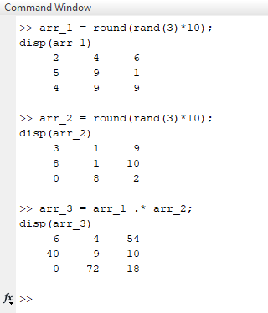
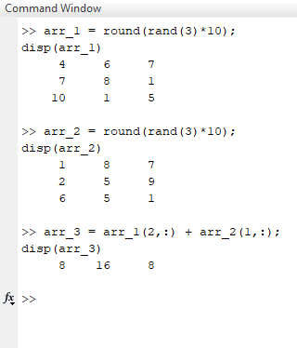
Array and matrix operations
Element-wise addition
Element-wise multiplication
Element-wise addition on array subsets

Slide 73
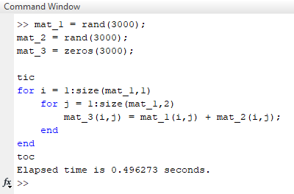
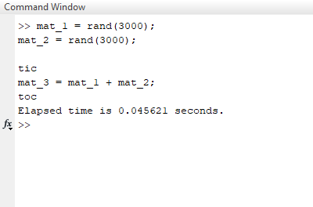
Array and matrix operations
Array operations offer massive speed improvements
Adding two 3000 x 3000 element arrays
Using loops
Time = 0.496 s
Using array operations
Time = 0.046 s

Slide 74
Array and matrix operations
Exercise: Multiplying arrays together
Use randi to create a pair of random integer 2D arrays with 4 rows and 3 columns. Values should be in the range 0-10.
Apply an element-wise multiplication and store the output as a new variable
Does the output array have the correct values?

Slide 75
Image processing
Notes:
Convert this into 2 spider diagrams if there’s time

Slide 76
Image loading
MATLAB has built-in functions for image loading/saving
Load generic formats (TIFF, JPEG, BMP, PNG) using imread
my_image = imread(‘Z:\Stephen\Courses\MATLAB\ExampleImage.png’);
Can also handle multipage TIFFs
slice_1 = imread(‘Z:\Stephen\Courses\MATLAB\StackImage.tif’,1);
slice_2 = imread(‘Z:\Stephen\Courses\MATLAB\StackImage.tif’,2);
For proprietary image formats we can use BioFormats Reader
We will cover this in Session 3

Slide 77
Image saving
Similarly, we can save images using imwrite
MATLAB chooses the format based on the specified extension
Saving TIFF: imread(my_image, ‘Z:\Stephen\Courses\MATLAB\OutputImage.tif’);
Saving PNG: imread(my_image, ‘Z:\Stephen\Courses\MATLAB\OutputImage.png’);
Saving JPEG: imread(my_image, ‘Z:\Stephen\Courses\MATLAB\OutputImage.jpg’);
Possible to save multipage TIFFs, but only in 3D
Use ‘writemode’, ‘append’ key-value pair
Saving slice 1: imread(my_image(:,:,1), ‘Z:\Stephen\OutputStack.tif’);
Saving slice 2: imread(my_image(:,:,2), ‘Z:\Stephen\OutputStack.tif’, ’writemode’, ’append’);
Saving slice 3: imread(my_image(:,:,3), ‘Z:\Stephen\OutputStack.tif’, ’writemode’, ’append’);
And so on…

Slide 78
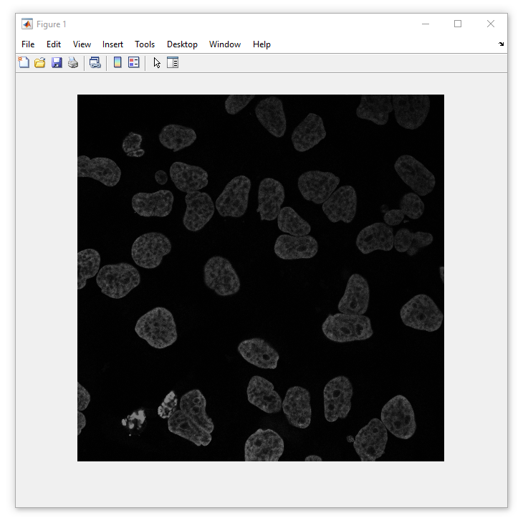
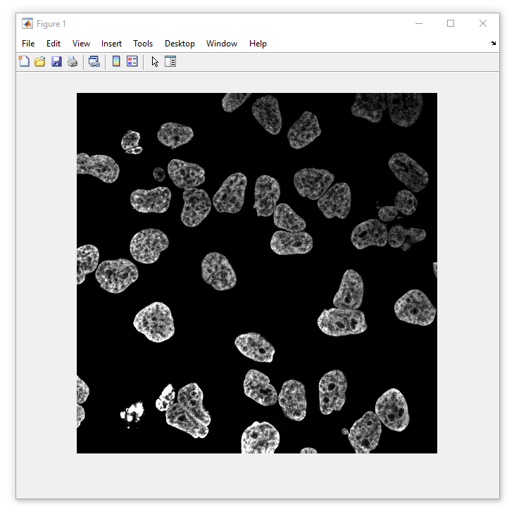
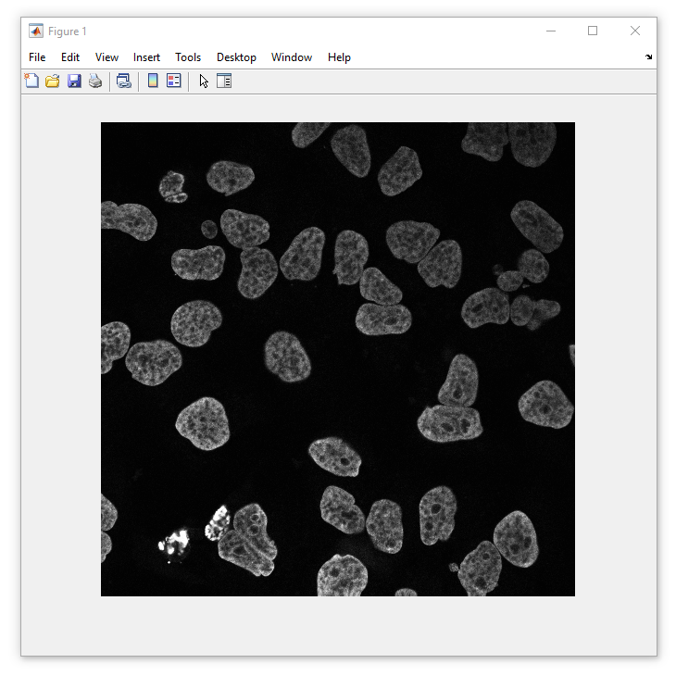
Visualising images
Display an image using imshow
Set intensity display range with optional second argument [min, max]
No scaling
imshow(my_im)
Specified scaling
imshow(my_im, [5, 80])
Auto-scaling
imshow(im_im, [])

Slide 79
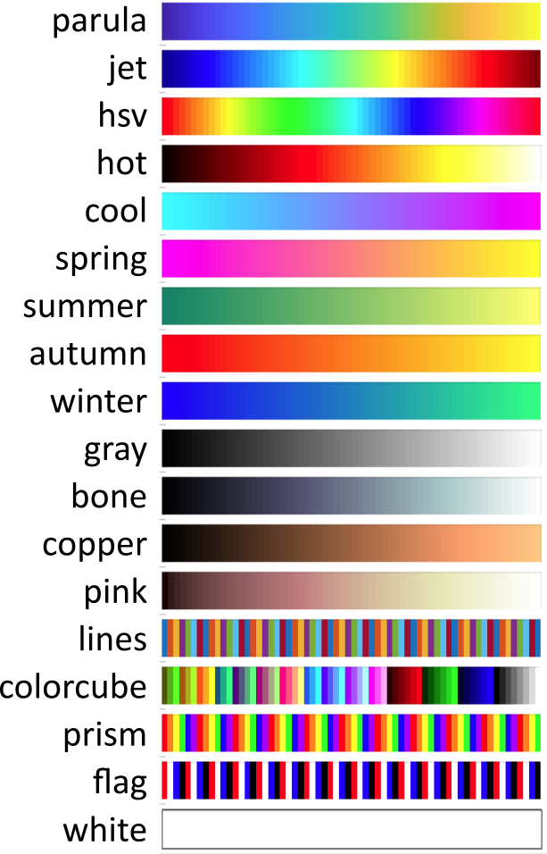
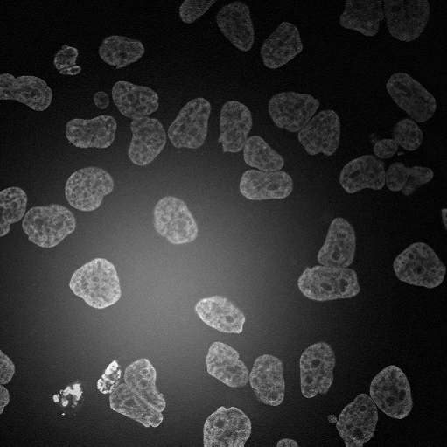

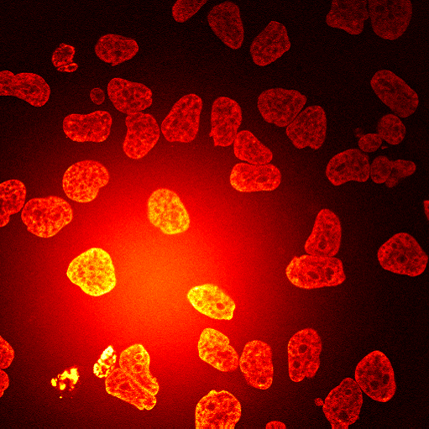
Visualising images
Changing the colourmap
Equivalent to ImageJ’s “Lookup tables” (LUTs)
Select a colourmap with colormap([name])
colormap(‘gray’)
colormap(‘parula’)
colormap(‘hot’)

Slide 80
Questions?!
Notes:
Convert this into 2 spider diagrams if there’s time

Slide 81
Under construction!
Comments/requests?
Let me know!
stephen.cross@bristol.ac.uk

